Slide 1
Process Synchronization
Background
The Critical-Section Problem
Synchronization Hardware
Semaphores
Classical Problems of Synchronization
Critical Regions
Monitors
Synchronization in Solaris 2 & Windows 2000
Operating System Concepts

Slide 2
Background
Concurrent access to shared data may result in data inconsistency.
Maintaining data consistency requires mechanisms to ensure the orderly execution of cooperating processes.
Shared-memory solution to bounded-butter problem (Chapter 4) allows at most n – 1 items in buffer at the same time. A solution, where all N buffers are used is not simple.
Suppose that we modify the producer-consumer code by adding a variable counter, initialized to 0 and incremented each time a new item is added to the buffer
Operating System Concepts

Slide 3
Bounded-Buffer
Shared data
#define BUFFER_SIZE 10
typedef struct {
. . .
} item;
item buffer[BUFFER_SIZE];
int in = 0;
int out = 0;
int counter = 0;
Operating System Concepts

Slide 4
Bounded-Buffer
Producer process
item nextProduced;
while (1) {
while (counter == BUFFER_SIZE)
; /* do nothing */
buffer[in] = nextProduced;
in = (in + 1) % BUFFER_SIZE;
counter++;
}
Operating System Concepts

Slide 5
Bounded-Buffer
Consumer process
item nextConsumed;
while (1) {
while (counter == 0)
; /* do nothing */
nextConsumed = buffer[out];
out = (out + 1) % BUFFER_SIZE;
counter--;
}
Operating System Concepts

Slide 6
Bounded Buffer
The statements counter++; counter--; must be performed atomically.
Atomic operation means an operation that completes in its entirety without interruption.
Operating System Concepts

Slide 7
Bounded Buffer
The statement “count++” may be implemented in machine language as: register1 = counter
register1 = register1 + 1 counter = register1
The statement “count—” may be implemented as: register2 = counter register2 = register2 – 1 counter = register2
Operating System Concepts

Slide 8
Bounded Buffer
If both the producer and consumer attempt to update the buffer concurrently, the assembly language statements may get interleaved.
Interleaving depends upon how the producer and consumer processes are scheduled.
Operating System Concepts

Slide 9
Bounded Buffer
Assume counter is initially 5. One interleaving of statements is: producer: register1 = counter (register1 = 5) producer: register1 = register1 + 1 (register1 = 6) consumer: register2 = counter (register2 = 5) consumer: register2 = register2 – 1 (register2 = 4) producer: counter = register1 (counter = 6) consumer: counter = register2 (counter = 4)
The value of count may be either 4 or 6, where the correct result should be 5.
Operating System Concepts

Slide 10
Race Condition
Race condition: The situation where several processes access – and manipulate shared data concurrently. The final value of the shared data depends upon which process finishes last.
To prevent race conditions, concurrent processes must be synchronized.
Operating System Concepts

Slide 11
The Critical-Section Problem
n processes all competing to use some shared data
Each process has a code segment, called critical section, in which the shared data is accessed.
Problem – ensure that when one process is executing in its critical section, no other process is allowed to execute in its critical section.
Operating System Concepts

Slide 12
Solution to Critical-Section Problem
1. Mutual Exclusion. If process P_{i} is executing in its critical section, then no other processes can be executing in their critical sections.
2. Progress. If no process is executing in its critical section and there exist some processes that wish to enter their critical section, then the selection of the processes that will enter the critical section next cannot be postponed indefinitely.
3. Bounded Waiting. A bound must exist on the number of times that other processes are allowed to enter their critical sections after a process has made a request to enter its critical section and before that request is granted.
Assume that each process executes at a nonzero speed
No assumption concerning relative speed of the n processes.
Operating System Concepts

Slide 13
Initial Attempts to Solve Problem
Only 2 processes, P₀ and P₁
General structure of process P_{i} (other process P_{j})
do {
entry section
critical section
exit section
reminder section
} while (1);
Processes may share some common variables to synchronize their actions.
Operating System Concepts

Slide 14
Algorithm 1
Shared variables:
int turn; initially turn = 0
turn - i ⇒ P_{i} can enter its critical section
Process P_{i}
do {
while (turn != i) ;
critical section
turn = j;
reminder section
} while (1);
Satisfies mutual exclusion, but not progress
Operating System Concepts

Slide 15
Algorithm 2
Shared variables
boolean flag[2]; initially flag [0] = flag [1] = false.
flag [i] = true ⇒ P_{i} ready to enter its critical section
Process P_{i}
do {
flag[i] := true; while (flag[j]) ; critical section
flag [i] = false;
remainder section
} while (1);
Satisfies mutual exclusion, but not progress requirement.
Operating System Concepts

Slide 16
Algorithm 3
Combined shared variables of algorithms 1 and 2.
Process P_{i}
do {
flag [i]:= true; turn = j; while (flag [j] and turn = j) ;
critical section
flag [i] = false;
remainder section
} while (1);
Meets all three requirements; solves the critical-section problem for two processes.
Operating System Concepts

Slide 17
Bakery Algorithm
Critical section for n processes
Before entering its critical section, process receives a number. Holder of the smallest number enters the critical section.
If processes P_{i} and P_{j} receive the same number, if i < j, then P_{i} is served first; else P_{j} is served first.
The numbering scheme always generates numbers in increasing order of enumeration; i.e., 1,2,3,3,3,3,4,5...
Operating System Concepts

Slide 18
Bakery algorithm of Lamport
Critical section algorithm for any n>1
Each time a process is requesting an entry to CS, assign it a ticket which is
Unique and monotonically increasing
Let the process into CS in the order of their numbers

Slide 19
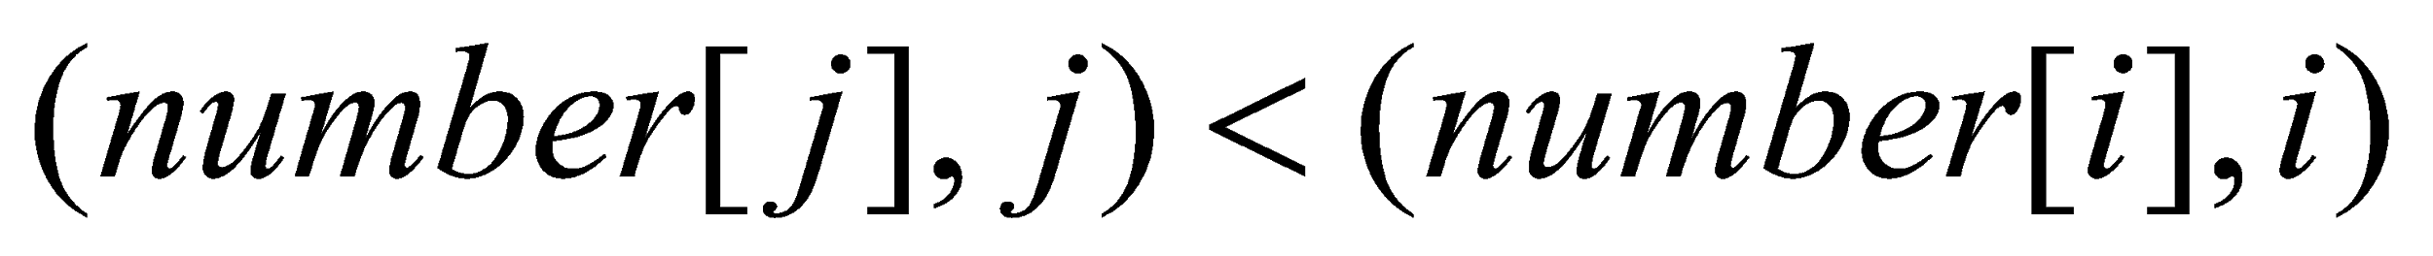
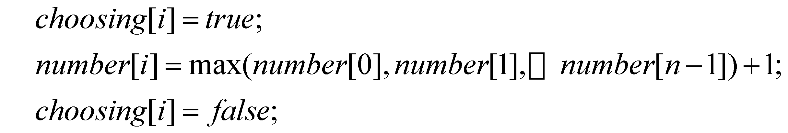
Choosing a ticket
Does not guarantee uniqueness! Use process Ids:
Process need to know that somebody perhaps
chose a smaller number:

Slide 20
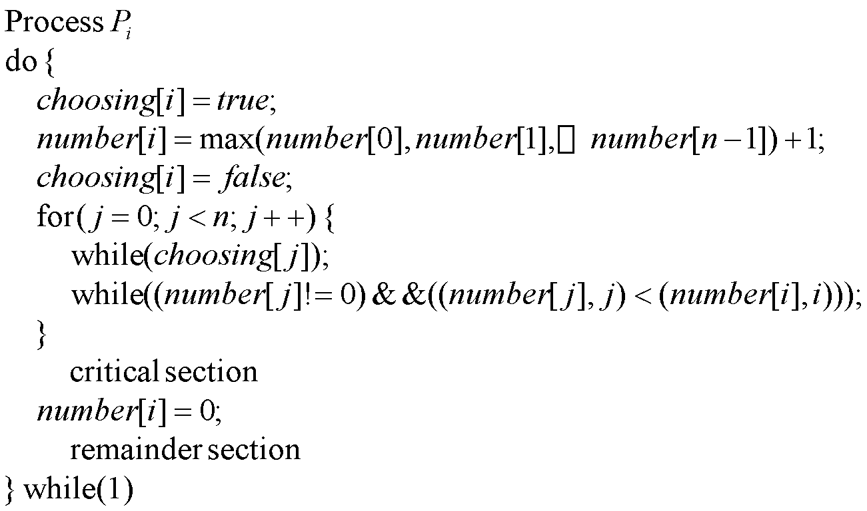
Bakery algorithm for n processes

Slide 21
Bakery algorithm for n processes
R
T
D
T-D
C
E
Notes:
‹#›

Slide 22
Structure of the algorithm
R – code prior to using Bakery algorithm
T – creating of a ticket and awaiting for permission to enter critical section
D – creation of a number (first part of a ticket)
T-D – awaiting for the permission to enter critical section
C – critical section itself
E – code executed upon exit from critical section
Notes:
‹#›

Slide 23


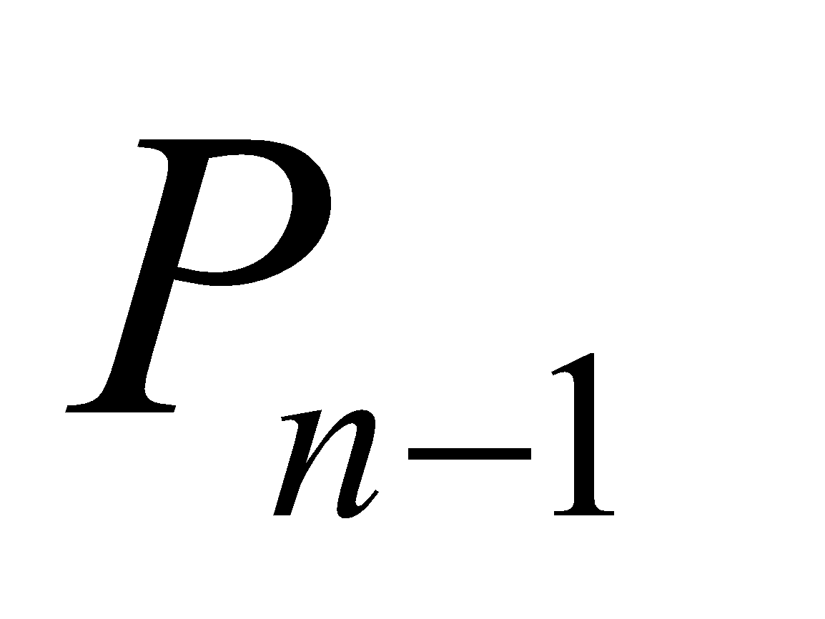
Remark on Fairness
A process that obtained a ticket (number[k],k) will wait at most for (n-1) turns, when other processes will enter the critical section
For example if all the processes obtained their tickets at the same time they will look like (q,1),(q,2)…(q,n)
In which case process will wait for processes … to complete the critical section.
Notes:
‹#›

Slide 24
Drawbacks of software solutions
Software solutions are very delicate ☺.
Processes that are requesting to enter their critical section are busy waiting (consuming processor time needlessly).
If critical sections are long, it would be more efficient to block processes that are waiting.
Notes:
‹#›

Slide 25
Hardware primitives
Elementary building blocks capable of performing certain steps atomically
Should be universal to allow for solving versatile synchronization problems
Numerous such primitives were identified:
Test-and-set
Fetch-and-add
Compare-and-swap

Slide 26
Synchronization Hardware
Shared data: boolean lock = FALSE;
Process P_{i}
do {
while (TestAndSet(&lock)) ;
critical section
lock = FALSE;
remainder section
}while(TRUE)
Test and modify the content of a word atomically .
boolean TestAndSet(boolean *target) {
boolean rv = *target;
*target = TRUE;
return rv;
}
Mutual Exclusion with Test-and-Set
Operating System Concepts

Slide 27
Discussion
Satisfies Mutual Exclusion and Progress
Does not satisfy Fairness
Provides exclusion among unbounded number of processes
Process IDs and number are unknown
Busy waiting
Burning CPU cycles while being blocked

Slide 28
Synchronization Hardware
Shared data (initialized to false): boolean lock;
boolean waiting[n];
Process P_{i}
do {
key = TRUE;
while (key == true)
Swap(&lock,&key);
critical section
lock = FALSE;
remainder section
}while(TRUE)
Atomically swap two variables.
void Swap(boolean *a, boolean *b) {
boolean temp = *a;
*a = *b;
*b = temp;
}
Mutual Exclusion with Swap
Operating System Concepts

Slide 29
Problems with studied synchronization methods
Critical section framework is inconvenient for programming
Performance penalty
Busy waiting
Too coarse synchronization
Using hardware primitives directly results in non-portable code

Slide 30
Semaphores
Synchronization tool that does not require busy waiting.
Semaphore S – integer variable
can only be accessed via two indivisible (atomic) operations
wait (S):
while S≤ 0 do no-op; S--;
signal (S):
S++;
Operating System Concepts

Slide 31
Critical Section of n Processes
Shared data:
semaphore mutex; //initially mutex = 1
Process Pi: do { wait(mutex); critical section
signal(mutex); remainder section } while (1);
Operating System Concepts

Slide 32
Semaphore Implementation
Define a semaphore as a record
typedef struct {
int value; struct process *L; } semaphore;
Assume two simple operations:
block suspends the process that invokes it.
wakeup(P) resumes the execution of a blocked process P.
Operating System Concepts

Slide 33
Implementation
Semaphore operations now defined as
wait(S): S.value--;
if (S.value < 0) {
add this process to S.L; block;
}
signal(S): S.value++;
if (S.value <= 0) {
remove a process P from S.L; wakeup(P);
}
Operating System Concepts

Slide 34
Semaphore as a General Synchronization Tool
Execute B in P_{j} only after A executed in P_{i}
Use semaphore flag initialized to 0
Code:
P_{i} P_{j}
 
A wait(flag)
signal(flag) B
wait (S):
while S≤ 0 do no-op; S--;
signal (S):
S++;
Operating System Concepts

Slide 35
Deadlock and Starvation
Deadlock – two or more processes are waiting indefinitely for an event that can be caused by only one of the waiting processes.
Let S and Q be two semaphores initialized to 1
P₀ P₁
wait(S); wait(Q);
wait(Q); wait(S);
 
signal(S); signal(Q);
signal(Q) signal(S);
Starvation – indefinite blocking. A process may never be removed from the semaphore queue in which it is suspended.
Operating System Concepts

Slide 36
Two Types of Semaphores
Counting semaphore – integer value can range over an unrestricted domain.
Binary semaphore – integer value can range only between 0 and 1; can be simpler to implement.
Can implement a counting semaphore S as a binary semaphore.
Operating System Concepts

Slide 37
Problems with Semaphores
Semaphores provide a powerful tool for enforcing mutual exclusion and coordinate processes.
But wait(S) and signal(S) are scattered among several processes. Hence, difficult to understand their effects.
Usage must be correct in all the processes (correct order, correct variables, no omissions).
Incorrect use of semaphore operations:
signal (mutex) …. wait (mutex)
wait (mutex) … wait (mutex)
Omitting of wait (mutex) or signal (mutex) (or both)
One bad (or malicious) process can fail the entire collection of processes.
A. Frank - P. Weisberg
Notes:
‹#›

Slide 38
Classical Problems of Synchronization
Bounded-Buffer Problem
Readers and Writers Problem
Dining-Philosophers Problem
Operating System Concepts

Slide 39
Bounded-Buffer Problem
Shared data semaphore full, empty, mutex; Initially: full = 0, empty = n, mutex = 1
Operating System Concepts

Slide 40
Bounded-Buffer Problem Producer Process
do {
…
produce an item in nextp
…
wait(empty);
wait(mutex);
…
add nextp to buffer
…
signal(mutex);
signal(full);
} while (1);
Operating System Concepts

Slide 41
Bounded-Buffer Problem Consumer Process
do {
wait(full)
wait(mutex);
…
remove an item from buffer to nextc
…
signal(mutex);
signal(empty);
…
consume the item in nextc
…
} while (1);
Operating System Concepts

Slide 42
Readers-Writers Problem
Shared data semaphore mutex, wrt; Initially mutex = 1, wrt = 1, readcount = 0
Operating System Concepts

Slide 43
Readers-Writers Problem Writer Process
do{
wait(wrt);
…
writing is performed
…
signal(wrt);
} while(TRUE);
Operating System Concepts

Slide 44
Readers-Writers Problem Reader Process
do{
wait(mutex);
readcount++;
if (readcount == 1)
wait(wrt);
signal(mutex);
…
reading is performed
…
wait(mutex);
readcount--;
if (readcount == 0)
signal(wrt);
signal(mutex):
} while (TRUE);
Operating System Concepts

Slide 45
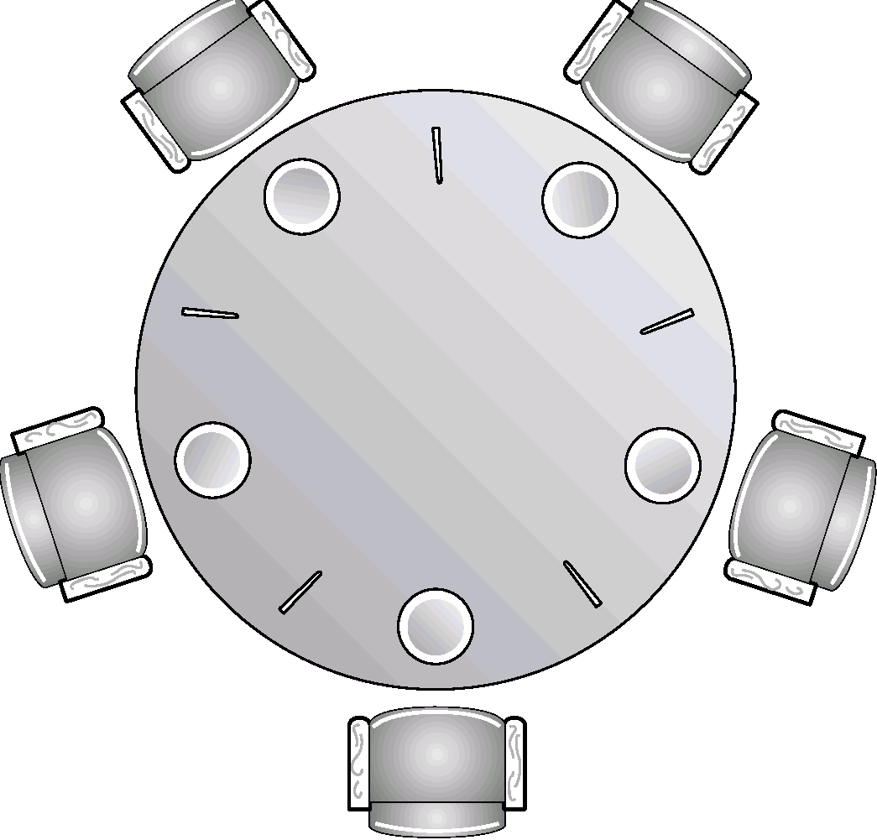
Dining-Philosophers Problem
Shared data
semaphore chopstick[5];
Initially all values are 1
Operating System Concepts

Slide 46
Dining-Philosophers Problem
Philosopher i:
do {
wait(chopstick[i])
wait(chopstick[(i+1) % 5])
…
eat
…
signal(chopstick[i]);
signal(chopstick[(i+1) % 5]);
…
think
…
} while (1);
Operating System Concepts

